Slide 1

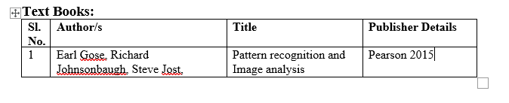
Text Books:
Text Books:

Slide 2
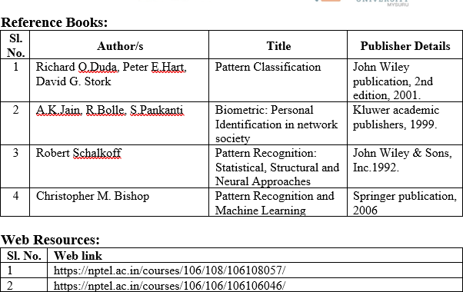
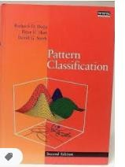
Reference Books and Web sources

Slide 3
UNIT - 1
Introduction: Applications of Pattern Recognition, Statistical Decision Theory and Analysis. Probability: Introduction to probability, Probabilities of Events, Random Variables, Joint Distributions and Densities, Moments of Random Variables, Estimation of Parameters from samples

Slide 4
Introduction: Definition
Pattern recognition is the theory or algorithm concerned with the automatic detection (recognition) and later classification of objects or events using a machine/computer.

Slide 5
Applications of Pattern Recognition
Some examples of the problems to which pattern recognition techniques have been applied are:
Automatic inspection of parts of an assembly line
Human speech recognition
Character recognition
Automatic grading of plywood, steel, and other sheet material
Identification of people from
finger prints,
hand shape and size,
Retinal scans
voice characteristics,
Typing patterns and
handwriting
Automatic inspection of printed circuits and printed characters
Automatic analysis of satellite picture to determine the type and condition of agricultural crops, weather conditions, snow and water reserves and mineral prospects.
Classification and analysis in medical images. : to detect a disease

Slide 6

Features and classes
Properties or attributesused to classify the objects are called features.
A collection of “similar” (not necessarily same) objects are grouped together as one “class”.
For example:
All the above are classified as character T
Classes are identified by a label.
Most of the pattern recognition tasks are first done by humans and automated later.
Automating the classification of objects using the same features as those used by the people can be difficult.
Some times features that would be impossible or difficult for humans to estimate are useful in automated system. For example satellite images use wavelengths of light that are invisible to humans.

Slide 7
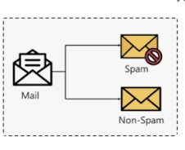
Two broad types of classification
Supervised classification
Guided by the humans
It is called supervised learning because the process of an algorithm learning from the training dataset can be thought of as a teacher supervising the learning process.
We know the correct answers, the algorithm iteratively makes
predictions on the training data and is corrected by the teacher.
Classify the mails as span or non span based on redecided parameters.
Unsupervised classification
Not guided by the humans.
Unsupervised Classification is called clustering.

Slide 8
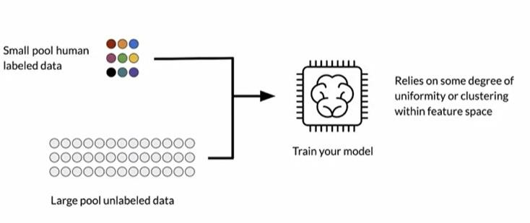
Another classifier : Semi supervised learning
It makes use of a small number of labeled data and a large number of unlabeled data to learn

Slide 9
Samples or patterns
The individual items or objects or situations to be classified will be referred as samples or patterns or data.
The set of data is called “Data Set”.

Slide 10
Training and Testing data
Two types of data set in supervised classifier.
Training set : 70 to 80% of the available data will be used for training the system.
In Supervised classification Training data is the data you use to train an algorithm or machine learning model to predict the outcome you design your model to predict.
Testing set : around 20-30% will be used for testing the system. Test data is used to measure the performance, such as accuracy or efficiency, of the algorithm you are using to train the machine.
Testing is the measure of quality of your algorithm.
Many a times even after 80% testing, failures can be see during testing,
reason being not good representation of the test data in the training set.
Unsupervised classifier does not use training data

Slide 11
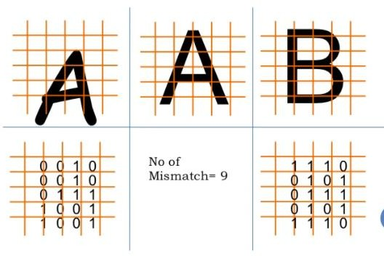
Statistical Decision Theory
Decision theory, in statistics, a set of quantitative methods for reaching optimal decisions.

Slide 12
Example for Statistical Decision Theory
Consider Hypothetical Basket ball Association:
The prediction could be based on the difference between the home team’s average number of points per game (apg) and the visiting team’s ‘apg’ for previous games.
The training set consists of scores of previously played games, with each home team is classified as winner or loser
Now the prediction problem is : given a game to be played, predict the home team to be a winner or loser using the feature ‘dapg’,
Where dapg = Home team apg – Visiting team apg

Slide 13
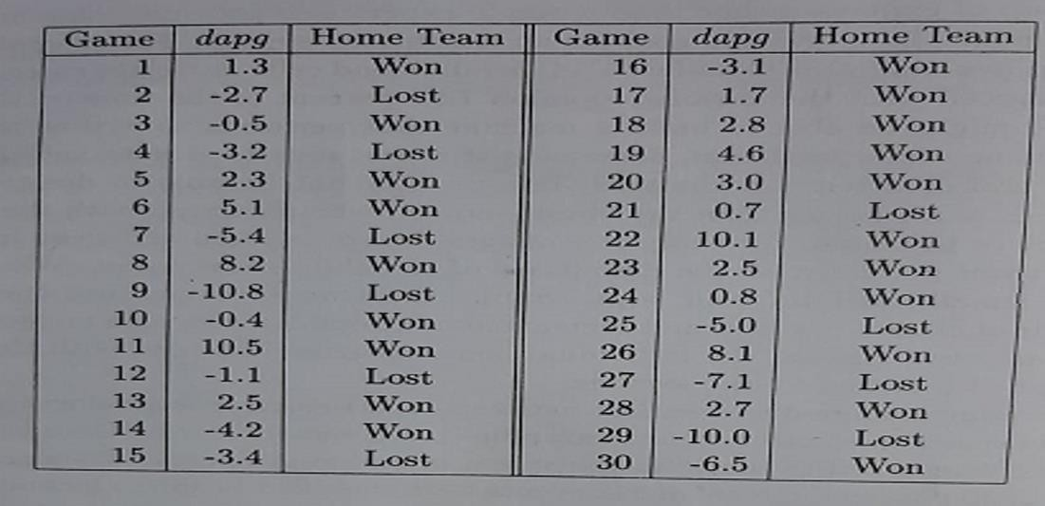
Data set of games showing outcomes, differences between average numbers of points scored and differences between winning percentages for the participating teams in previous games

Slide 14
The figure shown in the previous slide, lists 30 games and gives the value of dapg for each game and tells whether the home team won or lost.
Notice that in this data set the team with the larger apg usually wins.
For example in the 9th game the home team on average, scored 10.8 fewer points in previous games than the visiting team, on average and also the home team lost.
When the teams have about the same apg’s the outcome is less certain. For example, in the 10th game , the home team on average scored 0.4 fewer points than the visiting team, on average, but the home team won the match.
Similarly 12th game, the home team had an apg 1.1. less than the visiting team on average and the team lost.

Slide 15
Histogram of dapg
Histogram is a convenient way to describe the data.
To form a histogram, the data from a single class are grouped into intervals.
Over each interval rectangle is drawn, with height proportional to number of data points falling in that interval. In the example interval is chosen to have width of two units.
General observation is that, the prediction is not accurate with single
feature ‘dgpa’

Slide 16
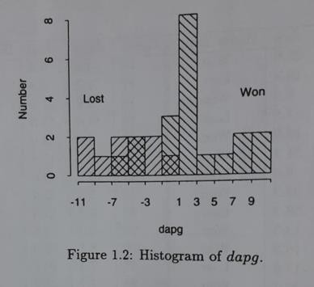


Lost
Won

Slide 17
Prediction
To predict normally a threshold value T is used.
‘dgpa’ > T consider to be won
‘dgpa’ < T consider to be lost
T is called decision boundary or threshold.
If T=-1, four samples in the original data are misclassified.
Here 3 winners are called losers and one loser is called winner.
If T=0.8, results in no samples from the loser class being misclassified as winner, but 5 samples from the winner class would be misclassified as loser.
IF T=-6.5, results no samples from the winner class being misclassified as losers, but 7 samples from the loser would be misclassified as winners.
By inspection, we see that when a decision boundary is used to classify the samples the minimum number of samples that are misclassified is four.
In the above observations, the minimum number of samples misclassified is 4 when T=-1

Slide 18
To make it more accurate let us consider two features.
Additional features often increases the accuracy of classification.
Along with ‘dapg’ another feature ‘dwp’ is considered.
wp= winning percentage of a team in previous games
dwp = difference in winning percentage between teams
dwp = Home team wp – visiting team wp

Slide 19
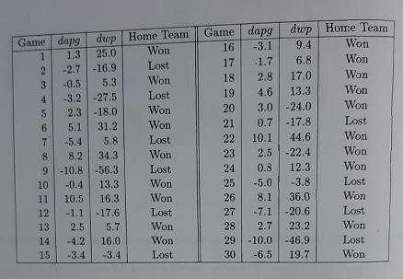
Data set of games showing outcomes, differences between average number of points scored and differences between winning percentages for the participating teams in previous games

Slide 20
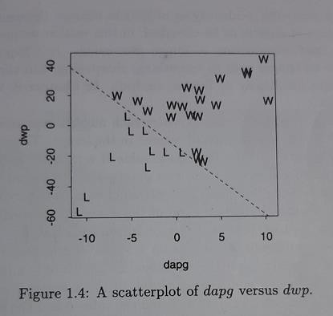
Now observe the results on a scatterplot
Each sample has a corresponding feature vector (dapg, dwp), which determines its position in the plot.
Note that the feature space can be classified into two decision regions by a straight line, called a linear decision boundary. (refer line equation). Prediction of this line is logistic regression.
If the sample lies above the decision boundary, the home team would be classified as the winner and it is below the decision boundary it is classified as loser.

Slide 21
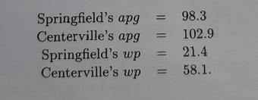
Prediction with two parameters.
Consider the following : springfield (Home team)
dapg= home team apg – visiting team apg = 98.3-102.9 = -4.6
dwp = Home team wp – visiting team wp = -21.4-58.1 = -36.7
Since the point (dapg, dwp) = (-4.6,-36.7) lies below the decision boundary, we predict that the home team will lose the game.

Slide 22
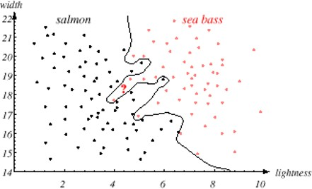
If the feature space cannot be perfectly separated by a straight line, a more complex boundary might be used. (non-linear)
Alternatively a simple decision boundary such as straight line might be used even if it did not perfectly separate the classes, provided that the error rates were acceptably low.

Slide 23
Simple illustration of Pattern Classification
A pattern/object can be identified by set of features.
Collection of features for a pattern forms feature vector.
Example : (in next slide)
P1 and P2 are two patterns with 3 features, so 3 Dimensional feature vector.
There are two classes C1 and C2.
P1 belongs to C1 and P2 belongs to C2
Given P, a new pattern with feature vector, it has to be classified into one of the
class based on the similarity value.
If d1 is the distance between (p and p1) and d2 is the distance between (p and
p2) then p will be classified into the class having least difference.

Slide 24
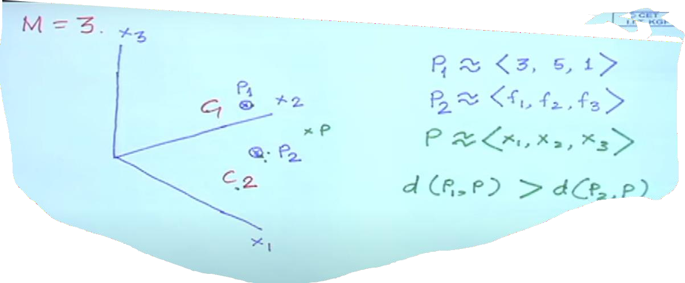

Slide 25
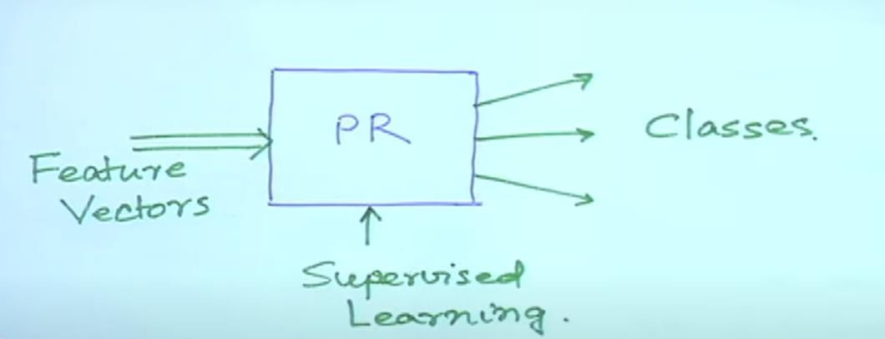
Block diagram of Pattern recognition and classification
Input to our pattern recognition system will be feature vectors and output will be decision about selecting the classes

Slide 26
Having the model shown in previous slide, we can use it for any type of recognition and classification.
It can be
speaker recognition
Speech recognition
Image classification
Video recognition and so on…

Slide 27
It is now very important to learn:
Different techniques to extract the features
Then in the second stage, different methods to recognize the pattern and classify
Some of them use statistical approach
Few uses probabilistic model using mean and variance etc.
Other methods are - neural network, deep neural networks
Hyper box classifier
Fuzzy measure
And mixture of some of the above

Slide 28
Examples for pattern recognition and classification

Slide 29
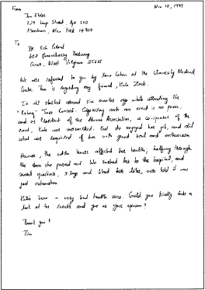

Handwriting Recognition
34

Slide 30
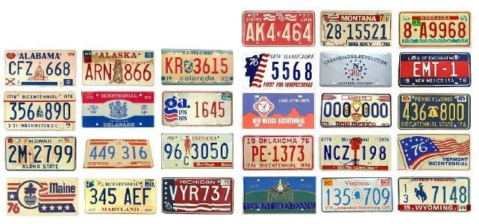
License Plate Recognition
35

Slide 31
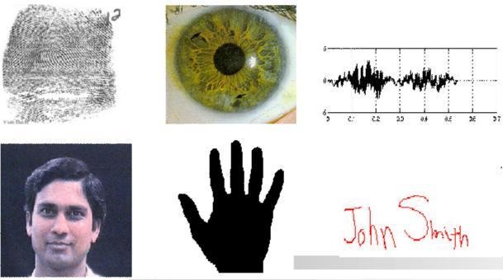
Biometric Recognition
36

Slide 32

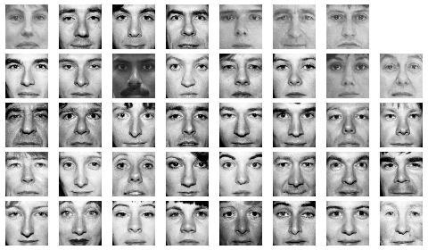
Face Detection/Recognition
Detection
Matching
Recognition
37

Slide 33
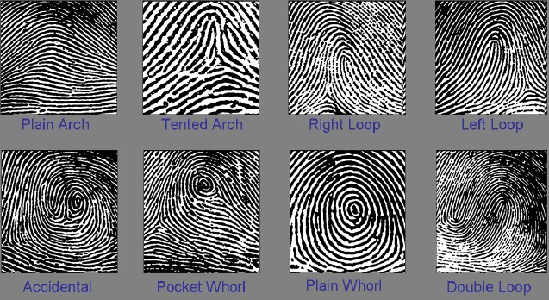
Fingerprint Classification
Important step for speeding up identification
38

Slide 34


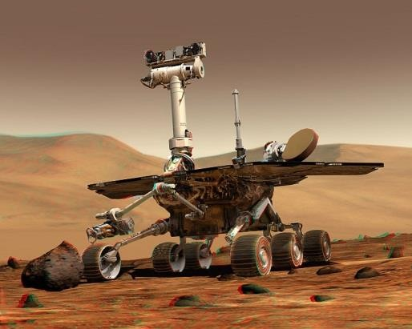
Autonomous Systems
Obstacle detection and avoidance
Object recognition
39

Slide 35
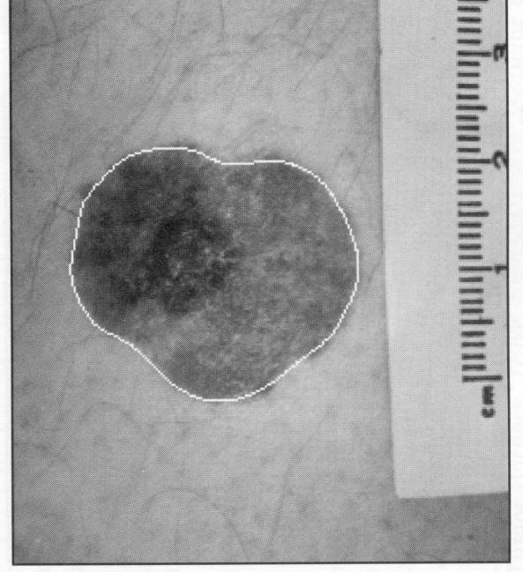
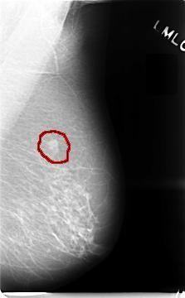
Medical Applications
Skin Cancer Detection
Breast Cancer Detection
40

Slide 36
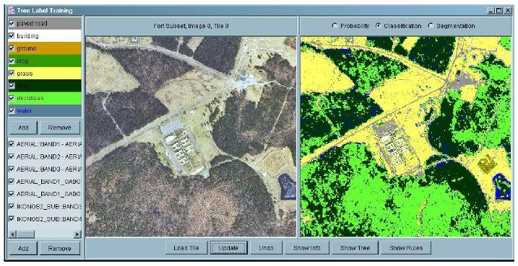
Land Cover Classification
(using aerial or satellite images)
Many applications including “precision” agriculture.
41

Slide 37
Probability: Introduction to probability
Probabilities of Events

Slide 38
What is covered?
Basics of Probability
Combination
Permutation
Examples for the above
Union
Intersection
Complement

Slide 39
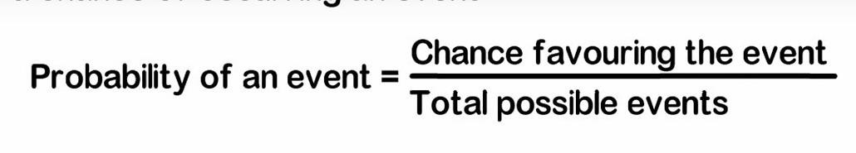
What is a probability
Probability is the branch of mathematics concerning numerical descriptions of how likely an event is to occur
The probability of an event is a number between 0 and 1, where, roughly speaking, 0 indicates that the event is not going to happen and 1 indicates event happens all the time.

Slide 40
Experiment
The term experiment is used in probability theory to describe a process for which the outcome is not known with certainty.
Example of experiments are:
Rolling a fair six sided die.
Randomly choosing 5 apples from a lot of 100 apples.

Slide 41
Event
An event is an outcome of an experiment. It is denoted by capital
letter. Say E1,E2… or A,B….and so on
For example toss a coin, H and T are two events.
The event consisting of all possible outcomes of a statistical experiment is called the “Sample Space”. Ex: { E1,E2…}

Slide 42

Examples
Sample Space of Tossing a coin = {H,T} Tossing 2 Coins = {HH,HT,TH,TT}

Slide 43
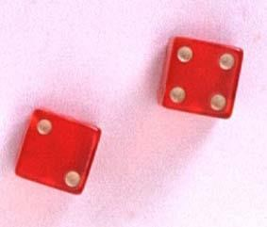



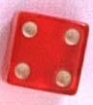
Example
The die toss:
Simple events:
Sample space:
E₁ E₂ E₃ E₄ E₅ E₆
1
S ={E₁, E₂, E₃, E₄, E₅, E₆}
2
S
3
E₁
•E
3
4
E₅
5
E₂
E₆
E₄
6

Slide 44


The Probability of an Event P(A)
The probability of an event A measures “how often” A will occur. We
write P(A).
Suppose that an experiment is performed n times. The relative frequency for an event A is
Number of times Aoccurs ₌ f
n n
If we let n get infinitely large,
P( A) = lim ^{f}
n→∞ n

Slide 45
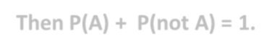

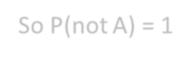

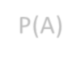
The Probability of an Event
P(A) must be between 0 and 1.
If event A can never occur, P(A) = 0. If event A always occurs when the
experiment is performed, P(A) =1.
Then P(A) + P(not A) = 1.
So P(not A) = 1-P(A)
The sum of the probabilities for all simple events in S equals 1.

Slide 46
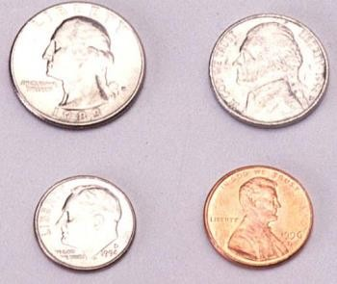
Example 1
Toss a fair coin twice. What is the probability of observing at least one head?
1st Coin
2nd Coin
E_{i} P(E_{i})
H
HH
1/4
1/4
1/4
1/4
P(at least 1 head)
= P(E₁) + P(E₂) + P(E₃)
= 1/4 + 1/4 + 1/4 = 3/4
H
T
HT
H
TH
T
T
TT

Slide 47
Example 2
A bowl contains three colour Ms®, one red, one blue and one green. A child selects two M&Ms at random. What is the probability that at least one is red?
1st M&M 2nd M&M E_{i} P(E_{i})
m
m
1/6
1/6
1/6
1/6
1/6
1/6
RB
m
P(at least 1 red)
= P(RB) + P(BR)+ P(RG) + P(GR)
= 4/6 = 2/3
RG
m
m
BR
m
BG
m
GB
m
m
GR

Slide 48
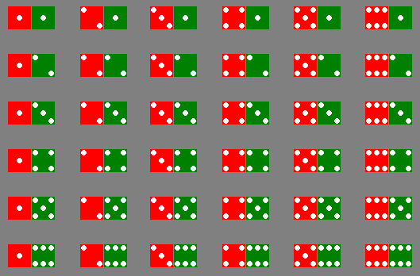
Example 3
The sample space of throwing a pair of dice is

Slide 49
Example 3
Event | Simple events | Probability
Dice add to 3 | (1,2),(2,1) | 2/36
Dice add to 6 | (1,5),(2,4),(3,3), (4,2),(5,1) | 5/36
Red die show 1 | (1,1),(1,2),(1,3), (1,4),(1,5),(1,6) | 6/36
Green die show 1 | (1,1),(2,1),(3,1), (4,1),(5,1),(6,1) | 6/36

Slide 50



Permutations
The number of ways you can arrange
n distinct objects, taking them r at a time is
n!
P^{n} =
r
(n − r)!
where n!= n(n −1)(n − 2)...(2)(1) and 0!≡ 1.
Example: How many 3-digit lock combinations can we make from the numbers 1, 2, 3, and 4?
4!
1!
The order of the choice is
important!
4
P =
= 4(3)(2) = 24
3

Slide 51


Examples
Example: A lock consists of five parts and can be assembled in any order. A quality control engineer wants to test each order for efficiency of assembly. How many orders are there?
The order of the choice is important!
5!
0!
5
P =
= 5(4)(3)(2)(1) = 120
5

Slide 52


Combinations
The number of distinct combinations of n distinct objects that can be formed, taking them r at a time is
n! r!(n − r)!
C^{n} =
r
Example: Three members of a 5-person committee must be chosen to form a subcommittee. How many different subcommittees could be formed?
 | _{C}5 3 | = | 5! 3!(5 − 3)! | ₌ 5(4)(3)(2)1 ₌ 5(4) 3(2)(1)(2)1 (2)1 | = 10
The order of the choice is
not important!

Slide 53
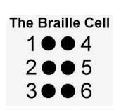
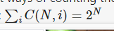
Is it combination or permutation?
Having 6 dots in a braille cell, how many different character can be made?
It is a problem of combination
C6,0+C 6,1 + C6,2 + C6,3+ C6,4+C6,5+ C6,6=1+6+15+20+15+6+1 = 64
(Why combination is used not permutation? : reason each dots is of same nature )
64 different characters can be made.
Where N is from 0 to 6. (It is the summation of combinations..)

Slide 54
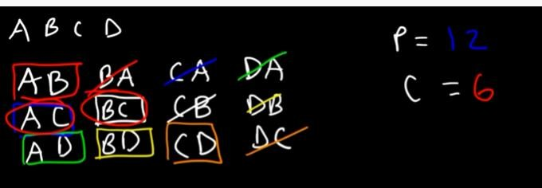
Having 4 characters, how may 2 character words can be formed:
Permutation : P6,2= 12 Combination: C6,2 = 6
Remember Permutation is larger than combination

Slide 55
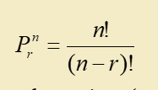
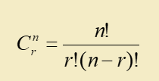
Summary:
So formula for Permutation is : (order is relevant)
Formula for Combination is: (Order is not relevant)

Slide 56
Event Relations

Slide 57
Special Events
The Null Event, is also called as empty event represented by - φ
φ = { } = the event that contains no outcomes
The Entire Event, The Sample Space - S S = the event that contains all outcomes

Slide 58
3 Basic Event relations
Union if you see the word or,
Intersection if you see the word and,
Complement if you see the word not.

Slide 59
Let A and B be two events, then the union of A
and B is the event (denoted by A∪B) defined by:
Union
A ∪ B = {e| e belongs to A or e belongs to B}
A ∪ B
A
B

Slide 60
The event A ∪ B occurs if the event A occurs or
the event and B occurs or both occurs.
A ∪ B
A
B

Slide 61
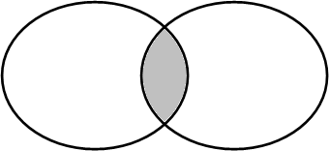
Intersection
Let A and B be two events, then the intersection of A and B is the event (denoted by A∩B) defined by:
A ∩ B = {e| e belongs to A and e belongs to B}
A ∩ B
A
B

Slide 62
The event A ∩ B occurs if the event A occurs and
the event and B occurs .
A ∩ B
A
B

Slide 63
Let A be any event, then the complement of A
(denoted by A ) defined by:
Complement
A = {e| e does not belongs to A}
A
A

Slide 64
The event A occurs if the event A does not occur
A
A

Slide 65
Mutually Exclusive
Two events A and B are called mutually exclusive if:
A ∩ B = φ
A
B

Slide 66
If two events A and B are mutually exclusive then:
1. They have no outcomes in common. They can’t occur at the same time. The outcome of the random experiment can not belong to both A and B.
A
B

Slide 67
Rules of Probability
Additive Rule Rule for complements

Slide 68
Probability of an Event E.
(revisiting … discussed in earlier slides)
Suppose that the sample space S = {o₁, o₂, o₃, … o_{N}} has a finite number,
N, of outcomes.
Also each of the outcomes is equally likely (because of symmetry). Then for any event E
n (E ) n (S )
n (E )
N total no. of outcomes
P[E]=
no. of outcomes in E
=
=
Note : the symbol n ( A)= no. of elements of A

Slide 69
Additive rule
(In general)
P[A ∪ B] = P[A] + P[B] – P[A ∩ B]
or
P[A or B] = P[A] + P[B] – P[A and B]

Slide 70
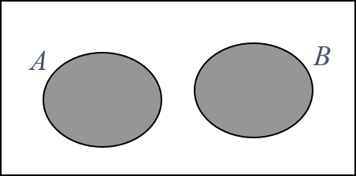
The additive rule (Mutually exclusive events) if A ∩ B = φ
P[A ∪ B] = P[A] + P[B]
i.e.
P[A or B] = P[A] + P[B]
if A ∩ B = φ
(A and B mutually exclusive)

Slide 71
A ∪ B
Logic
A
B
A ∩ B
When P[A] is added to P[B] the outcome in A ∩ B are counted twice
hence
P[A ∪ B] = P[A] + P[B] – P[A ∩ B]

Slide 72
P[ A ∪ B] = P[A]+ P[B]− P[A ∩ B]
Example:
Bangalore and Mohali are two of the cities competing for the National university games. (There are also many others).
The organizers are narrowing the competition to the final 5 cities.
There is a 20% chance that Bangalore will be amongst the final 5.
There is a 35% chance that Mohali will be amongst the final 5 and
an 8% chance that both Bangalore and Mohali will be amongst the final 5. What is the probability that Bangalore or Mohali will be amongst the final 5.

Slide 73
Solution:
Let A = the event that Bangalore is amongst the final 5. Let B = the event that Mohali is amongst the final 5.
Given P[A] = 0.20, P[B] = 0.35, and P[A ∩ B] = 0.08
What is P[A ∪ B]?
Note: “and” ≡ ∩, “or” ≡ ∪ .
P[ A ∪ B] = P[A]+ P[B]− P[A ∩ B]
= 0.20 + 0.35− 0.08 = 0.47

Slide 74
Find the probability of drawing an ace or a spade from a deck of cards.
There are 52 cards in a deck; 13 are spades, 4 are aces.
Probability of a single card being spade is: 13/52 Probability of drawing an Ace is : 4/52
= 1/4.
= 1/13.
Probability of a single card being both Spade and Ace = 1/52.
Let A = Event of drawing a spade . Let B = Event drawing Ace.
Given P[A] =1/4, P[B] =1/13, and P[A ∩ B] = 1/52
P[ A ∪ B] = P[A]+ P[B]− P[A ∩ B]
P[A ∪ B] = 1/4 + 1/13 – 1/52

Slide 75
Rule for complements

Slide 76
Rule for complements
The Complement Rule states that the sum of the probabilities of an event and its complement must equal 1, or for the event A, P(A) + P(A') = 1.
𝑃 𝐴^{ሜ}
= 1 − 𝑃 𝐴
or
P[not A] = 1− P[A]

Slide 77
Let A be any event, then the complement of A
(denoted by A ) defined by:
Complement
A = {e| e does not belongs to A}
A
A

Slide 78
The event A occurs if the event A does not occur
A
A

Slide 79
Logic:
A and A are mutually exclusive.
and S = A ∪ A
A
A
thus 1 = P[S ] = P[A]+ P ⎡⎣ A⎤⎦
and P ⎡⎣ A⎤⎦ = 1− P[A]

Slide 80
What Is Conditional Probability?
Conditional probability is defined as the likelihood of an event or outcome occurring, based on the occurrence of a previous event or outcome.
Conditional probability is calculated by multiplying the probability of the preceding event by the updated probability of the succeeding, or conditional, event.
Bayes' theorem is a mathematical formula used in calculating conditional probability.

Slide 81
Definition
Suppose that we are interested in computing the probability of event A and we have been told event B has occurred.
Then the conditional probability of A given B is defined to be:
P[ A ∩ B]
P ⎣⎡ A B⎦⎤ =
if P[B] ≠ 0
P[B]
Illustrates that probability of A, given(|) probability of B occurring

Slide 82
Rationale:
If we’re told that event B has occurred then the sample space is restricted to B.
The event A can now only occur if the outcome is in of
A ∩ B. Hence the new probability of A in Bis:
A
B
P ⎡ A B⎤ = ^{P[ A ∩ B]}
⎣ ⎦
P[B]
A ∩ B

Slide 83
An Example
Twenty – 20 World cup started:
For a specific married couple the probability that the husband watches the match is 80%,
the probability that his wife watches the match is 65%,
while the probability that they both watch the match is 60%.
If the husband is watching the match, what is the probability that his wife is also watching the match

Slide 84
Solution:
Let B = the event that the husband watches the match
P[B]= 0.80
Let A = the event that his wife watches the match
P[A]= 0.65 and
P[A ∩ B]= 0.60
P[ A ∩ B]
P ⎡⎣ A B⎦⎤ =
P[B]
= ^{0.60} = 0.75
0.80

Slide 85
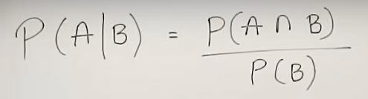
Another example
There are 100 Students in a class.
40 Students likes Apple
Consider this event as A, So probability of occurrence of A is 40/100 = 0.4
30 Students likes Orange.
Consider this event as B, So probability of occurrence of B is 30/100=0.3
20 Students likes Both Apple and Orange, So probability of Both A and B occurring is = A intersect B = 20/100 = 0.2
Remaining Students does not like either Apple nor Orange
What is the probability of A in B, means what is the probability that A is occurring given B :

Slide 86
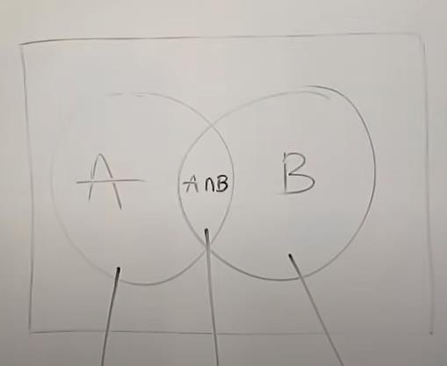
P(A|B) = 0.2/0.3 = 0.67
P(A|B) indicates that A occurring in the sample space of B.
40
20
30
Here we are not considering the entire sample space of 100 students, but only 30 students.

Slide 87
More Example Problem for Conditional Probability
Example : Calculating the conditional probability of rain given that the biometric pressure is high.
Weather record shows that high barometric pressure (defined as being over 760 mm of mercury) occurred on 160 of the 200 days in a data set, and it rained on 20 of the 160 days with high barometric pressure. If we let R denote the event “rain occurred” and H the event “ High barometric pressure occurred” and use the frequentist approach to define probabilities.
P(H) = 160/200 = 0.8
and P(R and H) = 20/200 = 0.10 (rain and high barometric pressure intersection)
We can obtain the probability of rain given high pressure, directly from the data.
P(R|H) = 20/160 = 0.10/0.80 = 0.125
Representing in conditional probability
P(R|H) = P(R and H)/P(H) = 0.10/0.8 = 0.125.

Slide 88
In my town, it's rainy one third (1/3) of the days.
Given that it is rainy, there will be heavy traffic with probability 1/2, and given that it is
not rainy, there will be heavy traffic with probability 1/4.
If it's rainy and there is heavy traffic, I arrive late for work with probability 1/2.
On the other hand, the probability of being late is reduced to 1/8 if it is not rainy and
there is no heavy traffic.
In other situations (rainy and no traffic, not rainy and traffic) the probability of being late
is 0.25. You pick a random day.
What is the probability that it's not raining and there is heavy traffic and I am not late?
What is the probability that I am late?
Given that I arrived late at work, what is the probability that it rained that day?

Slide 89
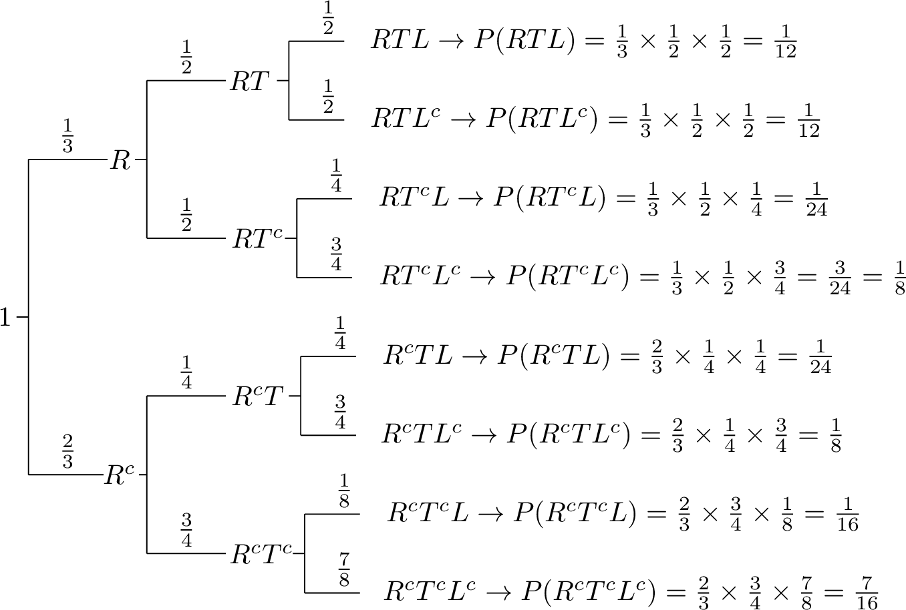

Slide 90
Let R be the event that it's rainy, T be the event that there is heavy traffic, and L be the event that I am late for work. As it is seen from the problem statement, we are given conditional probabilities in a chain format. Thus, it is useful to draw a tree diagram for this problem. In this figure, each leaf in the tree corresponds to a single outcome in the sample space. We can calculate the probabilities of each outcome in the sample space by multiplying the probabilities on the edges of the tree that lead to the corresponding outcome.
a. The probability that it's not raining and there is heavy traffic and I am not late can be found using the tree diagram which is in fact applying the chain rule:
P(Rc∩T∩Lc)
=P(Rc)P(T|Rc)P(Lc|Rc∩T)
=2/3⋅1/4⋅3/4
=1/8.

Slide 91
b. The probability that I am late can be found from the tree. All we need to do is sum the probabilities of the outcomes that correspond to me being late. In fact, we are using the law of total probability here.
P(L) =P(R and T and L)+P(R and Tc and L) + P(Rc and T and
Tc and L)
=1/12+1/24+1/24+1/16
=11/48.
c. We can find P(R|L) using
P(R|L)=P(R∩L)P(L)P(R|L)=P(R∩L)P(L).
L) + P(Rc and
We have already found P(L)=11/48 and we can find P(R∩L) similarly by adding the
probabilities of the outcomes that belong to R∩L.

Slide 92
Random Variables
Random variable takes a random value, which is real and can be finite or infinite and it is
generated out of random experiment.
The random value is generated out of a function.
Example: Let us consider an experiment of tossing two coins. Then sample space is S= { HH, HT, TH, TT}
Given X as random variable with condition: number of heads. X(HH) =2
X(HT) =1
X(TH) =1
X(TT) = 0

Slide 93
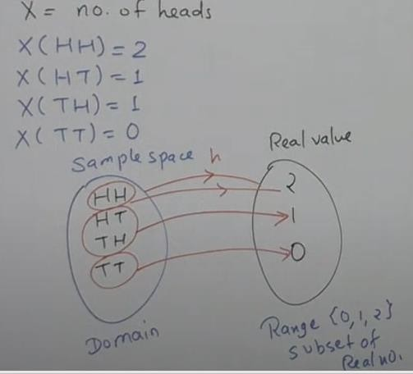

Slide 94
Two types of random variables
Discrete random variables
Continuous random variable

Slide 95
Discrete random variables
If the variable value is finite or infinite but countable, then it is called discrete random variable.
Example of tossing two coins and to get the count of number of heads is an example for discrete random variable.
Sample space of real values is fixed.

Slide 96
Continuous Random Variable
If the random variable values lies between two certain fixed numbers then it is called continuous random variable. The result can be finite or infinite.
Sample space of real values is not fixed, but it is in a range.
If X is the random value and it’s values lies between a and b then,
It is represented by : a <= X <= b
Example: Temperature, age, weight, height…etc. ranges between specific range.
Here the values for the sample space will be infinite

Slide 97
Probability distribution
Frequency distribution is a listing of the observed frequencies of all the output of an experiment that actually occurred when experiment was done.
Where as a probability distribution is a listing of the probabilities of all possible outcomes that could result if the experiment were done. (distribution with expectations).

Slide 98
Broad classification of Probability distribution
Discrete probability distribution
Binomial distribution
Poisson distribution
Continuous Probability distribution
Normal distribution

Slide 99
Discrete Probability Distribution: Binomial Distribution
A binomial distribution can be thought of as simply the probability of a SUCCESS or FAILURE outcome in an experiment or survey that is repeated multiple times. (When we have only two possible outcomes)
Example, a coin toss has only two possible outcomes: heads or tails and taking a test could have two possible outcomes: pass or fail.

Slide 100
Assumptions of Binomial distribution
(It is also called as Bernoulli’s Distribution)
Assumptions:
Random experiment is performed repeatedly with a fixed and finite number of trials.
The number is denoted by ‘n’
There are two mutually exclusive possible outcome on each trial, which are know as “Success” and “Failure”. Success is denoted by ‘p’ and failure is denoted by ‘q’. and p+q=1 or q=1-p.
The outcome of any give trail does not affect the outcomes of the subsequent trail.
That means all trials are independent.
The probability of success and failure (p&q) remains constant for all trials. If it does not remain constant then it is not binomial distribution. For example tossing a coin the probability of getting head or getting a red ball from a pool of colored balls, here every time after the ball is taken out it is again replaced to the pool.
With this assumption let see the formula

Slide 101
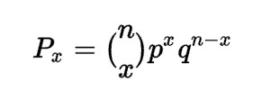
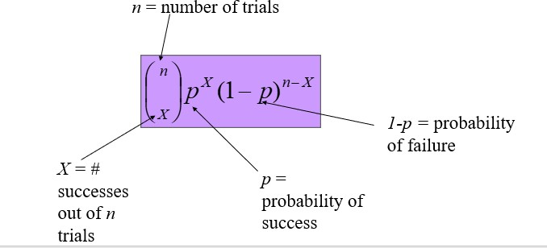
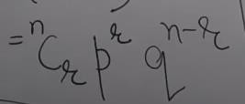
Formula for Binomial Distribution
OR
P(X=r) =
Where P is success and
q is failure

Slide 102
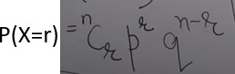
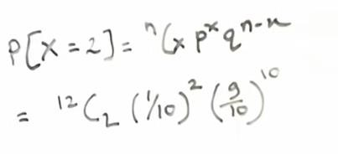
Binomial Distribution: Illustration with example
Consider a pen manufacturing company
10% of the pens are defective
(i)Find the probability that exactly 2 pens are defective in a box of 12
So n=12,
p=10% = 10/100 = 1/10
q= (1-q) =90/100 = 9/10
X=2

Slide 103
Consider a pen manufacturing company
10% of the pens are defective
(i)Find the probability that at least 2 pens are defective in a box of 12
So n=12,
p=10% = 10/100 = 1/10
q= (1-q) =90/100 = 9/10
X>=2
P(X>=2) = 1- [P(X<2)]
• = 1-[P(X=0) +P(X=1)]

Slide 104
Binomial distribution: Another example
If I toss a coin 20 times, what’s the probability of
getting exactly 10 heads?
⎛ 20 ⎞
10 10
⎜
⎟(.5) (.5) = .176
⎝10 ⎠

Slide 105
The Binomial Distribution: another example
Say 40% of the class is female.
What is the probability that 6 of the first 10 students walking in will be female?
⎛
n
⎞
P(x) =
⎜ ⎟
⎝ ^{x} ⎠
x n− x
p q
10
⎛ ⎞
6
10−6
= ⎜ ⎟(.4 )(.6
)
⎝ ⁶ ⎠
= 210(.004096)(.1296)
= .1115

Slide 106
Real-Life Examples of the Binomial Distribution
Example 1: Number of Side Effects from Medications
Medical professionals use the binomial distribution to model the probability that a certain number of patients will experience side effects as a result of taking new medications.
For example, suppose it is known that 5% of adults who take a certain medication experience negative side effects. We can use a Binomial Distribution Calculator to find the probability that more than a certain number of patients in a random sample of 100 will experience negative side effects.
P(X > 5 patients experience side effects) = 0.38400
P(X > 10 patients experience side effects) = 0.01147
P(X > 15 patients experience side effects) = 0.0004
And so on.

Slide 107
Example 2: Number of Fraudulent Transactions
Banks use the binomial distribution to model the probability that a certain number of credit card transactions are fraudulent.
For example, suppose it is known that 2% of all credit card transactions in a certain region are fraudulent. If there are 50 transactions per day in a certain region, we can use a Binomial Distribution Calculator to find the probability that more than a certain number of fraudulent transactions occur in a given day:
P(X > 1 fraudulent transaction) = 0.26423
P(X > 2 fraudulent transactions) = 0.07843
P(X > 3 fraudulent transactions) = 0.01776
And so on.
This gives banks an idea of how likely it is that more than a certain number of fraudulent transactions will occur in a given day.

Slide 108
Example 3: Number of Spam Emails per Day
Email companies use the binomial distribution to model the probability that a certain number of spam emails land in an inbox per day.
For example, suppose it is known that 4% of all emails are spam. If an account receives 20 emails in a given day, we can use a Binomial Distribution Calculator to find the probability that a certain number of those emails are spam:
P(X = 0 spam emails) = 0.44200
P(X = 1 spam email) = 0.36834
P(X = 2 spam emails) = 0.14580

Slide 109
Example 4: Shopping Returns per Week
Retail stores use the binomial distribution to model the probability that they receive a certain number of shopping returns each week.
For example, suppose it is known that 10% of all orders get returned at a certain store each week. If there are 50 orders that week, we can use a Binomial Distribution Calculator to find the probability that the store receives more than a certain number of returns that week:
P(X > 5 returns) = 0.18492
P(X > 10 returns) = 0.00935
P(X > 15 returns) = 0.00002
And so on.
This gives the store an idea of how many customer service reps they need to have in the store that week to handle returns.

Slide 110
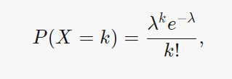
Poisson Distribution
The Poisson distribution is the discrete probability distribution of the number of events occurring in a given time period, given the average number of times the event occurs over that time period.
Formula
where
λ is the expected value(average of x),
k is number of events observed over a time period and e is Euler’s number.

Slide 111
A Poisson distribution is a discrete probability distribution, meaning that it gives the probability of a discrete (i.e., countable) outcome. For Poisson distributions, the discrete outcome is the number of times an event occurs, represented by k.
You can use a Poisson distribution to predict or explain the number of events occurring within a given interval of time or space.
You can use a Poisson distribution if:
Individual events happen at random and independently. That is, the probability of one event doesn’t affect the probability of another event.
You know the mean number of events occurring within a given interval of time or space. This number is called λ (lambda), and it is assumed to be constant.
When events follow a Poisson distribution, λ is the only thing you need to know to calculate the probability of an event occurring a certain number of times.

Slide 112
Examples of Poisson distributions
Horse kick deaths
One of the first applications of the Poisson distribution was by statistician Ladislaus Bortkiewicz. In the late 1800s, he investigated accidental deaths by horse kick of soldiers in the Prussian army. He analyzed 20 years of data for 10 army corps, equivalent to 200 years of observations of one corps.
He found that a mean of 0.61 soldiers per corps died from horse kicks each year. However, most years, no soldiers died from horse kicks. On the other end of the spectrum, one tragic year there were four soldiers in the same corps who died from horse kicks.
Using modern terminology:
A death by horse kick is an “event.”
The time interval is one year.
The mean number of events per time interval, λ, is 0.61.
The number of deaths by horse kick in a specific year is k.

Slide 113
Other examples of Poisson distributions
For example, a Poisson distribution could be used to explain or predict:
Text messages per hour
Machine malfunctions per year
Website visitors per month
Influenza cases per year

Slide 114
Continuous Probability Distributions
When the random variable of interest can take any value in an interval, it is called
continuous random variable.
– Every continuous random variable has an infinite, uncountable number of possible
values (i.e., any value in an interval).
Examples
Temperature on a given day, Length, height, intensity of light falling on a
given region.
The length of time it takes a truck driver to go from New York City to Miami.
The depth of drilling to find oil.
The weight of a truck in a truck-weighing station.
The amount of water in a 12-ounce bottle.
For each of these, if the variable is X, then x>0 and less than some maximum value possible, but it can take on any value within this range

Slide 115
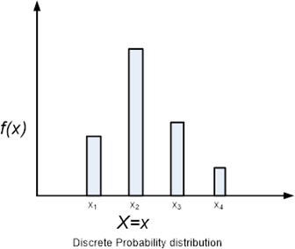
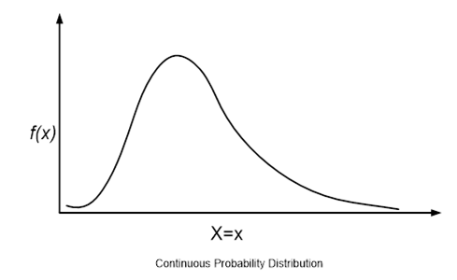
Continuous random variable differs from discrete random variable. Discrete random variables can take on only a finite number of values or at most a countable infinity of values.
A continuous random variable is described by Probability density function. This function is used to obtain the probability that the value of a continuous random variable is in the given interval.

Slide 116


Slide 117
Continuous Uniform Distribution
For Uniform distribution, f(x) is constant over the possible value of x.
Area looks like a rectangle.
For the area in continuous distribution we need to do integration of the function.
However in this case it is the area of rectangle.
Example to time taken to wash the cloths in a washing machine. (for a standard condition)

Slide 118
The Uniform distribution from a to b
Continuous Distributions
⎧
1
a ≤ x ≤ b
0 otherwise
f ( x) = ⎪b − a
⎨
⎪⎩
0.4
f ( x)
0.4
x)
0.3
0.2 ⎧
₁ ⎪
⎪
0.1 _{b − a} ⎨
⎪
⎪⎩
0
0 5 10 x 15
a _{b}
0.3
0.2
⎧
⎪
1 ⎪
0.1
b − a ⎨
⎪
⎪⎩
0
0
5
a
10
b
x
15

Slide 119
NORMAL DISTRIBUTION
The most often used continuous probability distribution is the normal distribution; it is also known as Gaussian distribution.
Its graph called the normal curve is the bell-shaped curve.
Such a curve approximately describes many phenomenon occur in nature, industry and
research.
– Physical measurement in areas such as meteorological experiments, rainfall studies and measurement of manufacturing parts are often more than adequately explained with normal distribution.

Slide 120
NORMAL DISTRIBUTION Applications:
The normal (or Gaussian) distribution, is a very commonly used (occurring) function in the fields of probability theory, and has wide applications in the fields of:
Pattern Recognition;
Machine Learning;
Artificial Neural Networks and Soft computing;
Digital Signal (image, sound , video etc.) processing
Vibrations, Graphics etc.

Slide 121


The probability distribution of the normal variable depends upon the two parameters 𝜇 and 𝜎
The parameter μ is called the mean or expectation of the distribution.
The parameter σ is the standard deviation; and variance is thus σ^2.
Few terms:
Mode: Repeated terms
Median : middle data (if there are 9 data, the 5th one is the median)
Mean : is the average of all the data points
SD- standard Deviation, indicates how much the data is deviated from the mean.
Low SD indicates that all data points are placed close by
High SD indicates that the data points are distributed and are not close by.
SD given by the formula (S)
Where S is sample SD
If you want population SD, represented by
and then divide by N not N-1

Slide 122

The Normal distribution
(mean μ, standard deviation σ)
1
₋( x−μ )²
f ( x) =
e
2σ ²
2πσ
A plot of normal distribution (or bell-shaped curve) where each band has a width of 1 standard deviation – See also: 68–95– 99.7 rule.
Standard Normal Distribution : In the above equation probability is computed for particular value of x. If you want a range then it has to be integrated.

Slide 123

For Standard Normal distribution:
For standard normal distribution, the area under the given range is given by:

Slide 124

Problem: Normal distribution
Consider an electrical circuit in which the voltage is normally distributed with mean 120 and standard deviation of 3. What is the probability that the next reading will be between 119 and 121 volts?
•

Slide 127


Slide 128

Another problem

Slide 129
Joint Distributions and Densities
The joint random variables (x,y) signifies that , simultaneously, the first feature has the value x and the second feature has the value y.
If the random variables x and y are discrete, the joint distribution function of the joint random variable (x,y) is the probability of P(x,y) that both x and y occur.
Thus, the joint distribution gives the probability of every possible combination of outcomes of the random variables that makeup the joint random variable.

Slide 130


Slide 131

Joint distribution in continuous random variable
If x and y are continuous, then the probability density function is used over the region R, where x and y is applied is used.
It is given by:
Where the integral is taken over the region R. This integral represents a volume in the xyp plane.

Slide 132
Moments of Random Variables
Moments are very useful in statistics because they tell us much about our data.
Moments describe how the probability mass of a random variable is distributed.
In mathematics, the moments of a function are quantitative measures related to the shape of the function's graph.
It gives information about the spread of data, skewedness and kurtosis.
If the function is a probability distribution, then there are four commonly used moments in statistics
The first moment is the expected value - measure of center of the data
The second central moment is the variance - spread of our data about the mean
The third standardized moment is the skewness - the shape of the distribution
The fourth standardized moment is the kurtosis - measures the peakedness or flatness of the distribution.

Slide 133

Computing Moments for population

Slide 134

Moment 3: To know the Skewness
In positive Skewness, Mean is > median and
Median>mode
And it is reverse in case of –ve skewness

Slide 135

Moment 4 : To know the Kurtosis

Slide 136


Slide 137

D

Slide 138

Normal Distribution
Consider an example of x values:
4,5,5,6,6,6,7,7,8
Mode, Median and mean all will be equal
• = Mode is 6
• = Median is 6
• = Mean is also 6

Slide 139

Positive Skew
Consider an example of x values:
5,5,5,6,6,7,8,9,10
(It is an example for Normal Distribution)
• = Mode is 5
• = Median is 6
• = Mean is also 6.8

Slide 140

+ve skew

Slide 141

-ve skew

Slide 142

Difference between PDF and PMF

Slide 143
Moments for random variable:
The “moments” of a random variable (or of its distribution) are expected values of powers or related functions of the random variable.

Slide 144
Formula for Computing Kth Central moment of Random variable
The k^{th} central moment of X
μ
⎡
( )
k
⎤
0
= E
X − μ
k
⎣
⎦
⎧ ∑( x − μ )^{k} p ( x)
if X is discrete
₌ ⎪
x
⎨ ∞
⎪ ∫ ( x − μ )^{k}
f ( x) dx
if X is continuous
⎪⎩-∞

Slide 145


Let X be a discrete random variable having support x = <1, 2> and the pmf is
uUsing this compute mean (first order moment)
First order moment is the mean. Solution:

Slide 146

For example computation of 3rd Order moment
The third central moment of can be computed as follows:
Here X value is 1 and 2 and Probability is ¾ and ¼ respectively. Consider Mean is 5/4

Slide 147
Estimation of Parameters from Samples
There are 3 kinds of estimates for these parameters:
Method of moments estimates
Maximum likelihood estimates
Unbiased estimates.

Slide 148
End of Unit 1

